Slide 1

Ethical and Legal Considerations in Clinical Research in the Kingdom of Saudi
Institution:
Course:
Name:

Slide 2

Comprehensive Protocol review
Initial step to protect participants.
IRB ensures ethical review of protocols.
Proposals receive a rigorous scientific review.
Potential risks are pointed out.
Notes:
Human participants of a clinical research study in the Kingdom of Saudi are protected by ensuring that there is a comprehensive protocol review. This is normally carried out before the start of any given research. The IRB goes through the ethical review protocols in order to provide the participants with protection at the start and as the research continues. The experts ensures that they have carried out a comprehensive ethical review to ensure that they have noted the areas that might pose potential risks to the participants. They should also ensure that a research has been based on sound statistical principles, and sample sizes, ending rules, and endpoints are clearly spelt out.

Slide 3

Cont…,
Reviews protocol for financial conflicts.
Protocols might pose conflict of interest.
Management strategies to deal with the issue.
Notes:
The research process should be exposed to review with regard to presence of potential financial conflicts of interest. Both the organization and the individuals should be screened for possible financial conflicts of interest. In case of presence of any given potential financial conflict of interest, a program element other than the IRB should be allocated to deal with the issue (Federman, Hanna, & Rodriguez, 2002). In addition, it should be ensured that all the three aspects of the proposal review which include; financial conflict, ethics and science are weaved together through the analyses of every given project. Once this has been done, the findings should be communicated to the IRB in a clear manner.

Slide 4

Ethically Sound Participant-Investigator Interactions
Interaction between the investigator and participant is important.
Investigator to adhere to :
Ethical standards.
Obligations.
Investigators’ potential conflicts of interest.
Notes:
Interactions between the participants and the investigators are significant in ensuring protection of the participants taking part in the research. In case of there being a fully developed system and the investigators fail to adhere to the set forth ethical standards and obligations, the research system will not work appropriately. In addition, in case of a clinical trial whereby the investigator is a treating physicians, they should ensure that their own potential conflicts of interests are well known (Federman, et al., 2002). For instance, the physician might have potential financial conflicts of interest and it will be good if they are made known to the IRB or any other designated institutional body (Al Sayyari, Hejaili, & Shaheen, 2016).

Slide 5

Ongoing Safety Monitoring
Ongoing monitoring is important.
Correlation of protocol review and risk.
Risk-benefit assessment shouldn’t be altered.
Programs could be made better by:
Improved federal guidance.
Funding.
Restructuring of the review and monitoring process.
Notes:
The researchers should ensure that there is an ongoing monitoring of the research process. In order to ensure that there is effectiveness in the process, it is important to make sure that the ongoing monitoring activities are correlated to the risk level that is exposed to the research participants (Federman, et al., 2002). This means that in case of high-risk studies, there should be put in place regular ongoing safety monitoring in order to prevent the emerging data or evidence from causing changes to the risk-benefit assessment to a point where they can be made to be useless. On the other hand, the process could be made better by having in place improved federal guidance and funding as well as via some changes in the review and monitoring processes.

Slide 6
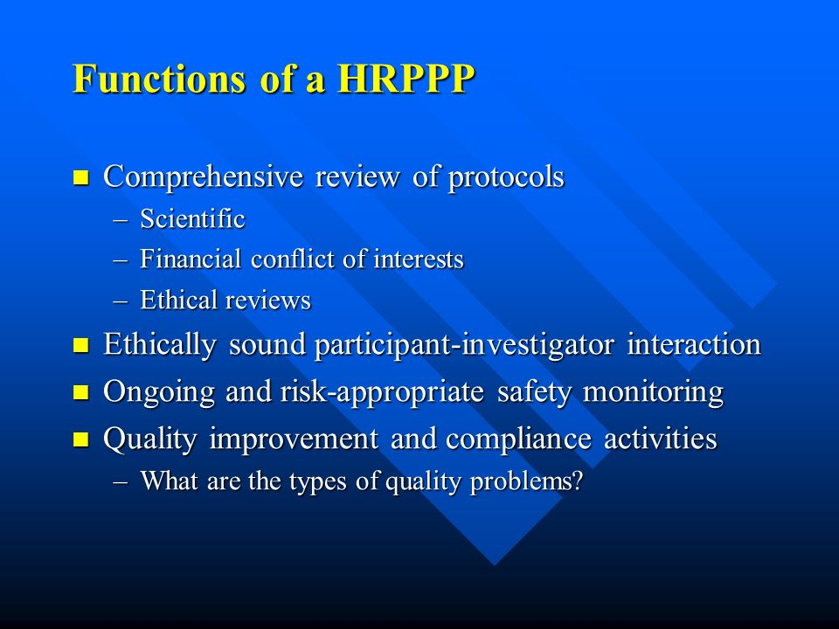
Quality Improvement and Compliance
To ensure the program is functioning adequately:
Assess institution.
Ensure investigator compliance.
Implement a CQI program.
Compliance assurances issued by DHHS
Inspections of IRBs conducted by FDA.
Institutional audits.
Notes:
In order to ensure that the research program is functioning adequately, there should be ensured implementation of a CQI program, investigator compliance and institutional assessment. There exists various mechanisms for assessing such compliance which include; institutional audits, site inspections for participant protection, site inspections carried out by FDA on IRBs and compliance with assurances that are issued by DHHS and some other various federal departments (Federman, et al., 2002). However, there are some institutions that have already created mechanisms for assessing the investigators and IRB compliance with the set forth regulations. These institutions have varying capabilities for monitoring investigator compliance; there are those also who lack such capabilities.

Slide 7
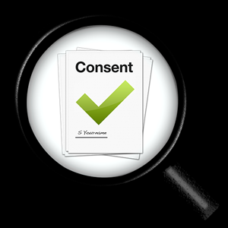
Best Consent Practices
Comparing Consent policy.
CMS guidelines.
Audit actual processes to confirm their alignment.
Interviewing of patients.
Write the consent document in easy-to-understand language
Describe the patient’s procedure
Notes:
In addition to mitigating the risks involved in a research study, the execution of a well-informed consent is required. Informed consent has the potential to impact the various players involved in the research such as patients, staff and the entire care process in general. One of the best practices of consent is that of making comparison between a researcher’s consent policy and processes against the guidelines stipulated by the CMS (Gallin, & Ognibene, 2012). The researcher should ensure that his or her actual processes are in alignment with the CMS guidelines. The other best practice of consent is that of interviewing the patients. The researcher should ensure that the patients or the participants were satisfied with the informed consent discussion.

Slide 8

Best Consent Practices
Address consent for possible procedures.
Make sure that consent process includes:
Disclosure.
Documentation of possible procedures.
Consent forms to allow for emergent procedures
List the possible procedures.
Notes:
The researcher or clinical officer should ensure that he or she has covered all the necessary information in the consent form. Treatment might involve several procedures and there might also be some other possible additional procedures which might emerge in the treatment process. Therefore, it is important for the medical professional to ensure that he or she has captured all the necessary information in the consent form (Gallin, et al., 2012). However, many consent forms contains language that gives the medical professional the authority to carry out additional or necessary procedures based on their clinical judgment. The clinicians should ensure that all the likely to be carried out procedures are listed in the consent form.

Slide 9

Best Consent Process
Consent review to be done.
Availability of a signed consent.
Surgical team review consent form.
Completion of consent documentation early.
Allows thoughtful and detail conversation.
Notes:
Making consent review part of the surgical safety checklist is important. Generally, verification of a signed consent form is a must. However, the clinicians should ensure that they have carried a thorough check on the consent form in order to ensure that every required detail is captured. The documentation of the consent form should also be completed earlier enough to give way for a thoughtful and detailed conversation between the clinician and the patient (Regmi, Aryal, Kurmi, Pant, Van Teijlingen, & Wasti, 2017). This will give the patient a chance to be given all the necessary information in order to aide in making an informed decision. In addition, the documentation could be best carried out outside the walls of the health facilities.

Slide 10

Best Consent Practice
Automate the consent process.
Paper-based obtaining of consent.
Automation eliminates need for a paper.
Electronic consent supports form version.
Prevents omissions and errors.
Provides an easy-to-understand transcript.
Notes:
Automation of the consent process will have various benefits. One of the benefits is that of the identification and correction of deficiencies and documentation errors. Electronic consent eliminated the need of the paper. This is because it provides a form version that can be used in place of the paper. It has information that is required plus the blanks that are to be filled by the patient or the research participants (Regmi, et al., 2017). The information can be shared easily amongst the medical practitioners if need be. Finally, they provide an easy-to-understand transcript that eases the discussion process between the patient and the medical professional.

Slide 11
References
Al Sayyari, A., Hejaili, F., & Shaheen, F. (2016). Interaction between Society and Medical Ethics in Saudi Arabia. Anthropology of the Middle East, 11(2), 60-75.
Federman, D.D., Hanna, K.E., & Rodriguez, L.L. (2002). A Systematic Approach to Human Research Participant Protection Programs. Retrieved from: https://www.ncbi.nlm.nih.gov/books/NBK43560/
Gallin, J.I., & Ognibene, F.P. (2012). Principles and practice of clinical research. (3rd ed.).USA: Academic Press.
Regmi, P.R., Aryal, N., Kurmi, O., Pant, P.R., Van Teijlingen, E., & Wasti, S.P. (2017). Informed consent in health research: challenges and barriers in low-and middle-income countries with specific reference to Nepal. Developing world bioethics, 17(2), 84-89.

